Slide 1
Building an Interactive Wine Recommendation Application
Rutgers Data Science Bootcamp 2019
Maria Javier
Madeline Starr
Mark Visco

Slide 2
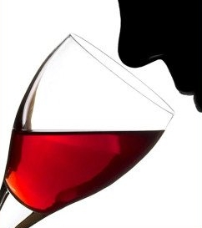
Talking about wine
Wine has a very complex flavor profile
The stereotype of wine tasting:
Swirling, nose in glass, slurping, spitting
“Flavor” = Taste + Aroma
Aromas are sensed externally and internally!

Slide 3
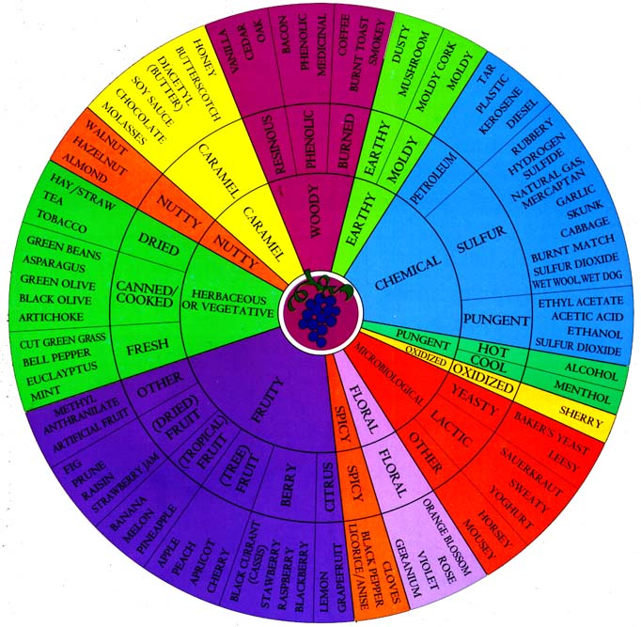
UC David Wine Aroma Wheel
People who talk about wines need a common lexicon
UC Davis originated the “Wine Aroma Wheel”
Groups and categorizes aromas common to wines
Covers both positive and negative attributes

Slide 4

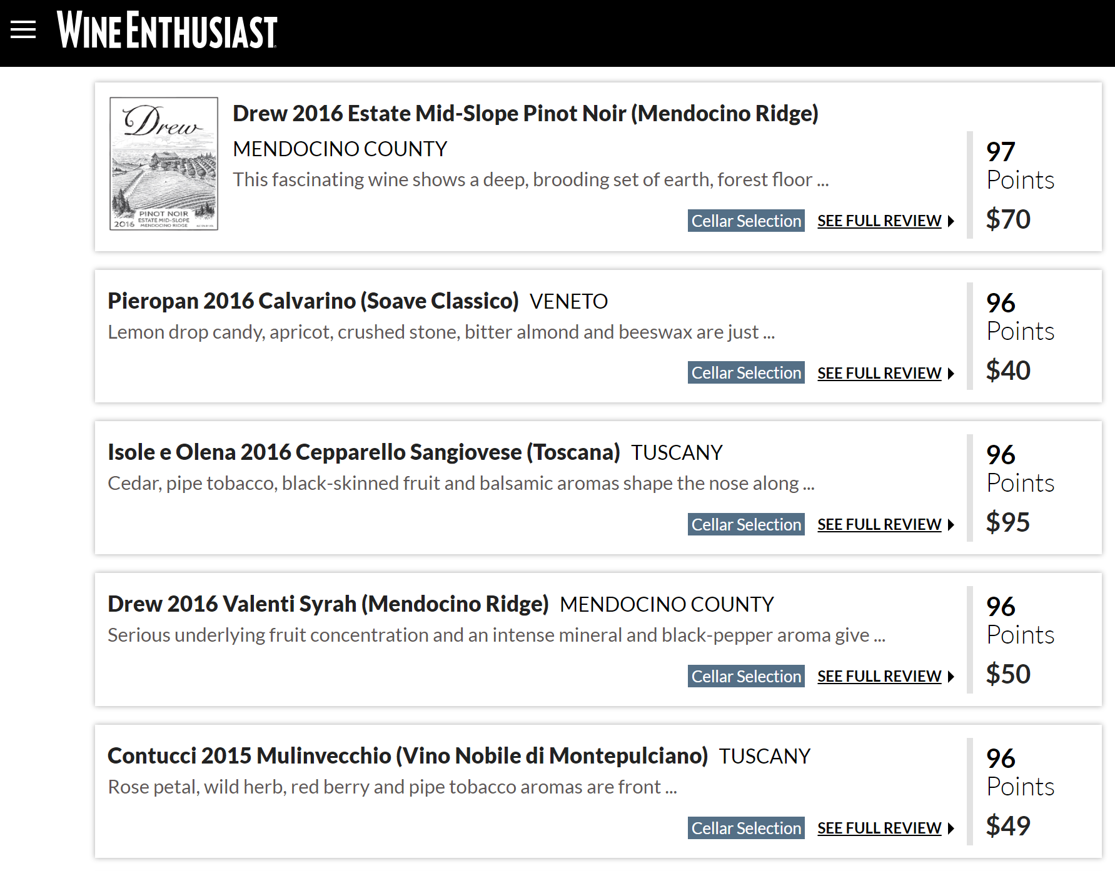
Wine Reviews

Slide 5

Website Demonstration
https://wine-recommendations-2017.herokuapp.com

Slide 6
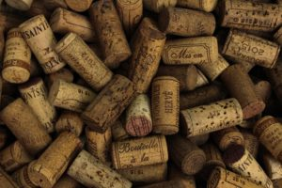
First step: Data munging
150,000+ reviews of 2017 wines, scraped and shared on Kaggle.com by Zack Thoutt
Data set included scores, winery, varietal, and full review text
Using Python, Pandas, and Jupiter notebook:
The text of the reviews was split into individual words and matched against the aromas listed on the Wine Wheel

Slide 7
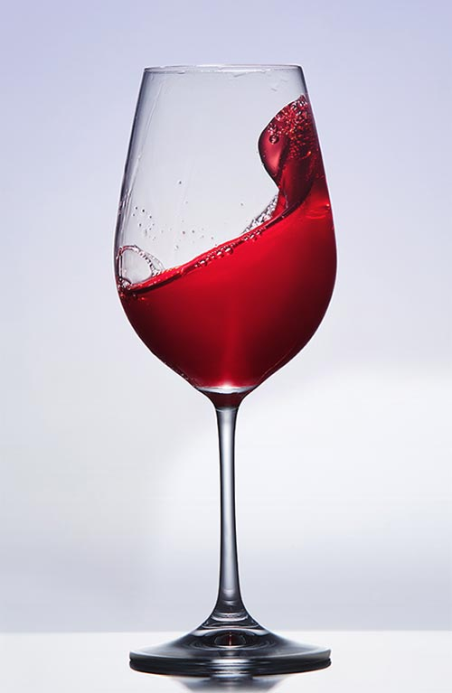
Second step: Data munging (cont’d)
Files received included score and price average, wine counts and wine descriptions. Wine descriptions increased original 150k+ records to 400k+ records.
Using Postgresql :
Took the files from above and transformed them into groupings based upon the wine wheel categories.
Additional manipulation involved averages and concatenations along with column appending.

Slide 8
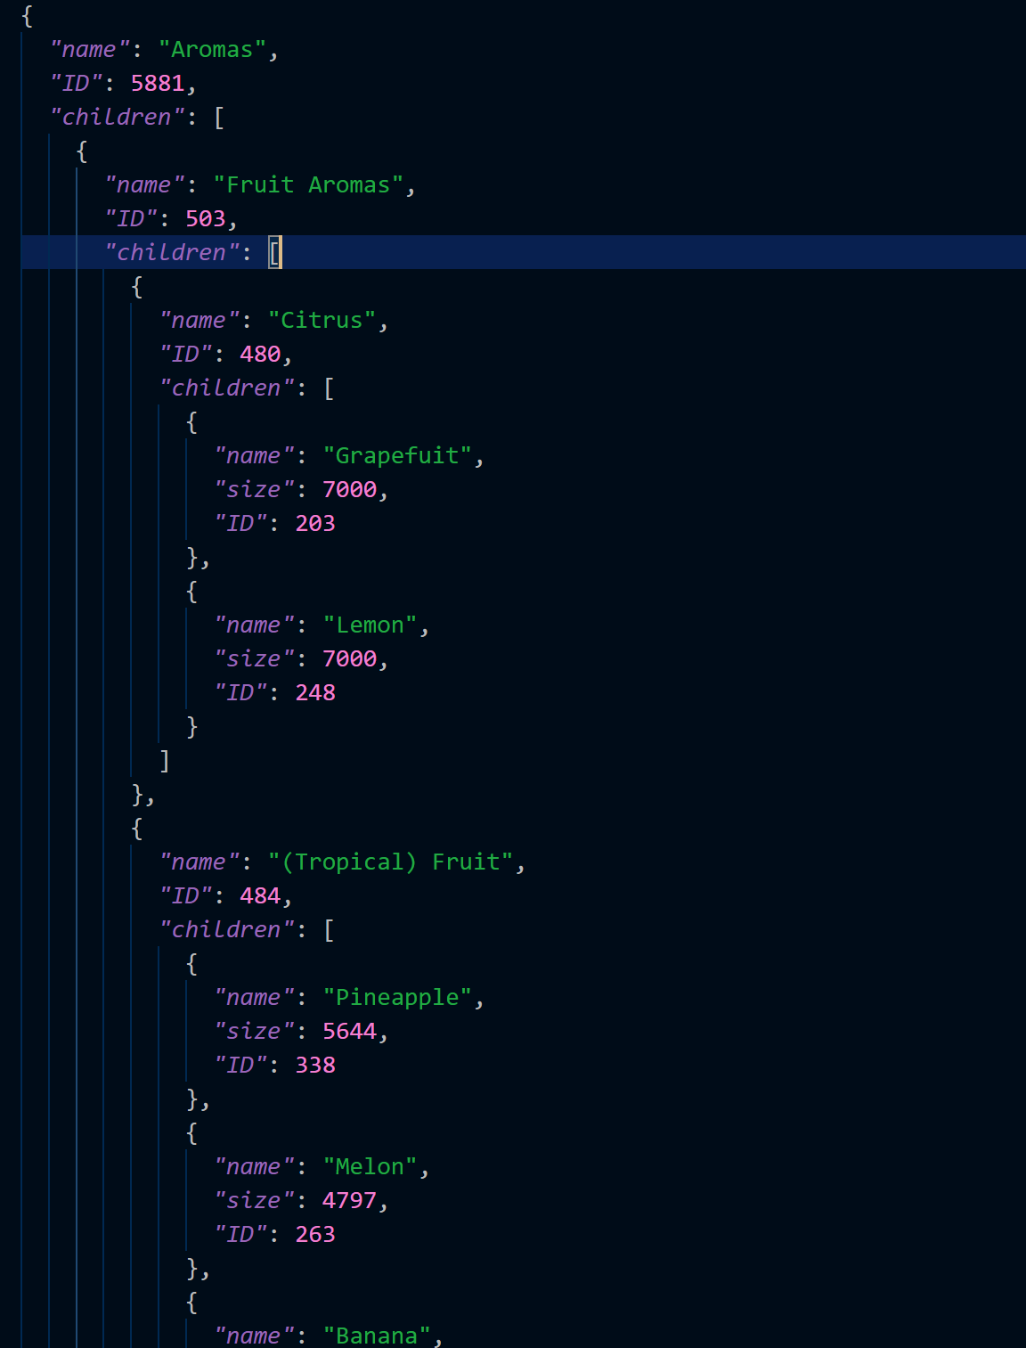
Third step: App development
Used HTML, Flask, Javascript, CSS, D3 and SQLite
Main Visualization: Zoomable Sunburst diagram
Originated by Mike Bostock
Involves a lot of slicing
A LOT of slicing
The backbone is a hierarchical JSON

Slide 9
Third step: App development (continued)
We finally understand why Javascript is so prevalent:
The functions called by the onclick event
Selecting a wedge, zooming in on the segment, and populating the wine recommendations
Only took 24 lines of code
(Building the sunburst took quite a few more)

Slide 10
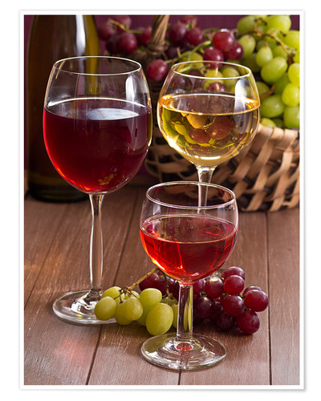
Fourth step: Website Development

Slide 11

Fourth step: Deploy to Heroku
Uploaded all files to GitHub with proper formatting needed for Heroku.
Uploaded and linked to Heroku.

Slide 12
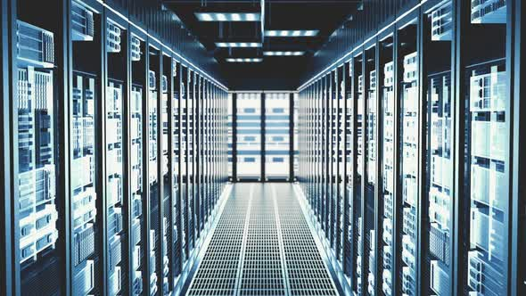
Technologies used
Python
Pandas
Jupyter Notebook
PostgreSQL
Flask
Javascript
D3
CSS
Heroku

Slide 13
Any questions?

